Slide 1
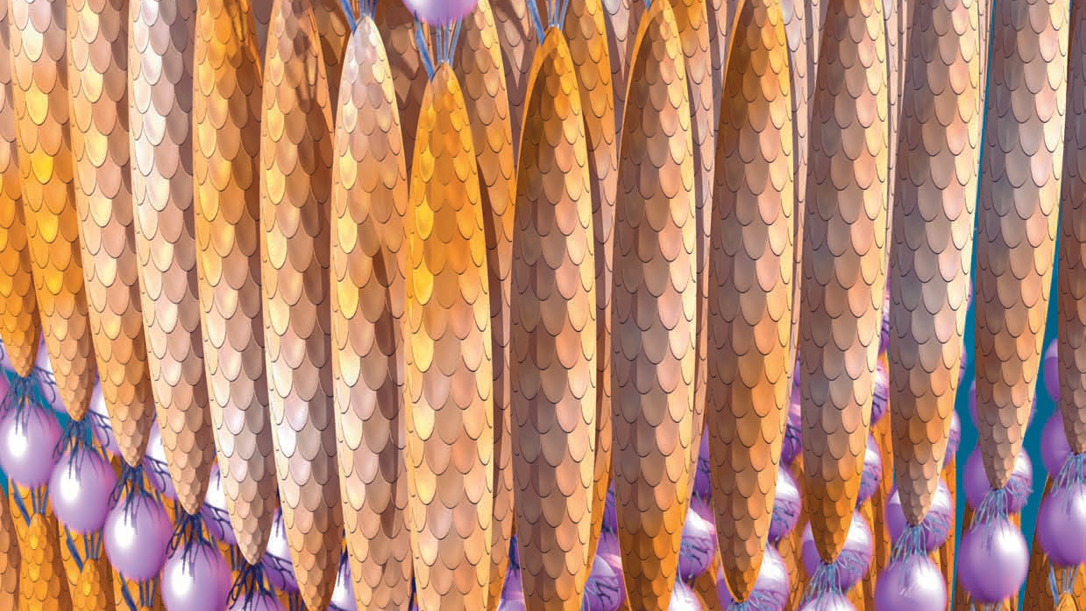
Viral Nanoelectronics
M.I. T. breeds viruses that coat themselves in selected substances, then self-assemble into such devices as liquid crystals, nano- wires and electrodes.

Slide 2
3-D LIQUID CRYSTAL depicted in this artist’s representation consists of multiple copies of a phage
(a bacteria-infecting virus) called M13 (gold) that bound to inorganic nanocrystals (pink) and assembled themselves into an ordered array.
Such films could be used in flexible displays.

Slide 3
Nano Electronics
Materials scientists were curious to find how the abalone, a marine snail, constructed its magnificently strong shell from unpromising minerals. (Angela M. Belcher)
In an experiment a thin glass was slipped between the abalone and its shell, then removed.
A flat pearl was observed.
Could be used to study shell formation on an hour-by-hour basis, without having to sacrifice the animal.
It was observed that the abalone manufactures proteins that induce calcium carbonate molecules to adopt two distinct yet seamlessly melded crystalline forms—one strong, the other fast-growing.

Slide 4
Nano Electronics
Need for biological agents that could move molecules around like so many bricks, building structures from the ground up, a strategy known in the nanotechnology world as self-assembly.
And, for a critter more tractable than the abalone, is something of a one note small, spry and flexible.
Earlier monoclonal antibodies were tried because they can be engineered to stick to many different things, but they proved hard to work with.

Slide 5
Nano Electronics(M13 Phage)
M13 phage, a long, skinny virus that parasitizes bacteria but is harmless to humans.
Roughly six nanometers wide and a micron long, encloses its single strand of DNA in a protein coat.
With some 2,700 copies of one kind of protein lining the filamentous body.
And a few copies each of several other kinds of protein capping the ends.

Slide 6
M13 VIRUS
p3
p6
p8 (major coat protein)
Long and Skinny.
The M13 virus is about a micron long and six nano-meters wide.
Its single loop of DNA is sheathed in a coat composed of the protein p8 and a smattering of other proteins.
Variations in any of the proteins can alter the properties of the virus, often in ways useful to device construction.
p7
p9

Slide 7
Nano Electronics(M13 Phage)
The different kinds of proteins can be engineered to vary from phage to phage, making for a billion possible permutations, each conferring particular chemical affinities.
A phage might stick to one material along its sides, another at one end, and still another at the opposite end.
Chemical specificity has long been exploited by biologists, who use M13 phages that bind to particular organic substances to identify unknown samples.

Slide 8
Nano Electronics(M13 Phage Features)
It was shown that the virus could also tag and manipulate inorganic molecules, such as the metals and semiconductors that lie at the heart of so many useful products.
A process called directed evolution was used to get a phage that binds to the right molecule.
Amplification could provide with trillions of copies of a promising subset of phages for another stage of evolution.
Thus, the conditions in the solution altered to make it a little harder for the phages to bond to the target material.

Slide 9
Nano Electronics(M13 Phage Features)
The less sticky variants are washed off, the survivors are amplified, and the process is repeated under still more demanding conditions.
At the end of the process, only one phage variant remained—the most selectively sticky of them all.
Example- A phage was with a highly specific taste for gold was put into a solution containing gold ions.
It gilded itself into a wire-let a micron long, suitable for connecting adjacent elements in a microcircuit.

Slide 10
Nano Electronics(M13 Phage Features)
A variant of this phage can even link up with its fellows to form a gold wire many centimeters long, which can be spun like thread and woven into cloth fabric.
Such a wire, bonded to chemically sensitive receptors, might detect toxic or biologically threatening agents.
The experimental merit of various other organisms have been examined so far.
M13-- because its immense length-to width ratio makes it naturally assemble into more complex shapes.

Slide 11
Nano Electronics(M13 Phage Features)
M13 phages were selected to form a film 10 centimeters square and less than a micron thick,
The structure was then fixed into a stable sheet by throwing in the odd chemical cross-linkage.
Applications-- developing such sheets as electrodes for an ultralight lithium-ion battery.
The negative electrode can be formed from a sheet of phages bred to encrust themselves in gold and cobalt oxide.
The gold was used to increase conductivity, the cobalt oxide to exchange ions with the battery electrolyte.

Slide 12
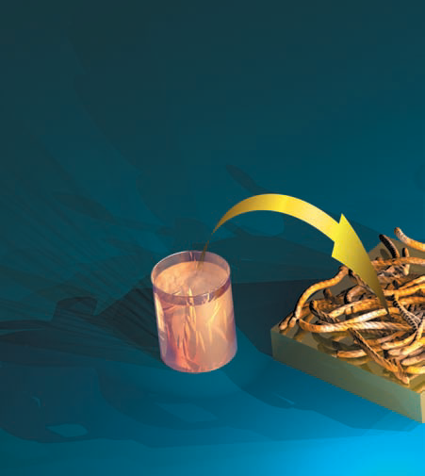
A NEW KIND OF BATTERY
The experiment depicts M13 variants as building blocks for electrodes in flexible lightweight lithium-ion batteries.
An M13 variant was selected that can bind to cobalt oxide, a substance able to store lithium ions.
Copies of the virus was put on an electrolyte film containing lithium.
M13

Slide 13
Nano Electronics(M13 Phage Features)
Such ion exchange is what moves charge from one electrode to the other.
The electrode assembles directly on a prepatterned polymer electrolyte, forming a bilayer.
Phages were also grown to obtain a positive counter electrode that will stick to the other side of the electrolyte.
The goal was to shape the sheets into a solid with positive and negative electrodes alternating on the surface so they may be connected in series for higher voltage.

Slide 14
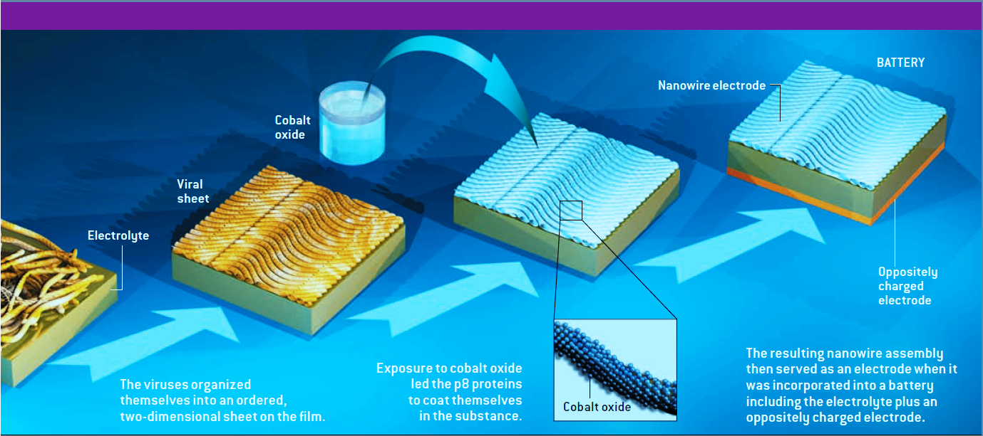

Slide 15
Nano Electronics(M13 Phage Features)
The short distances between electrodes permit fast charging and discharging and allow for the optimal use of components.
Specificity- One phage is specific for the semiconductor gallium arsenide and is insensitive to its close cousin gallium nitride, giving it a power of discrimination that might allow it to detect flaws in chips.
Chipmakers sometimes grow crystals of one of these substances on top of some other semiconductor so that the slightly different spacing of the crystalline lattices will induce mechanical strain, which in turn will affect electronic behaviour.

Slide 16
Nano Electronics(M13 Phage Features)
When the crystals do not mesh properly, the occasional atom will jut out where it should not, creating a defect to which a phage can stick.
If such a phage also bears a fluorescent tag, it will then glow under the right conditions, and a microscope can pinpoint the defect.

Slide 17
Nano Electronics (Future Research)
Coax M13 phages into building complete transistors from molecules of semiconductors.
Getting M13 to bind both to cancer cells and to nanodevices known as quantum dots that show up in medical body scans.
Flexible screens.

